Slide 1
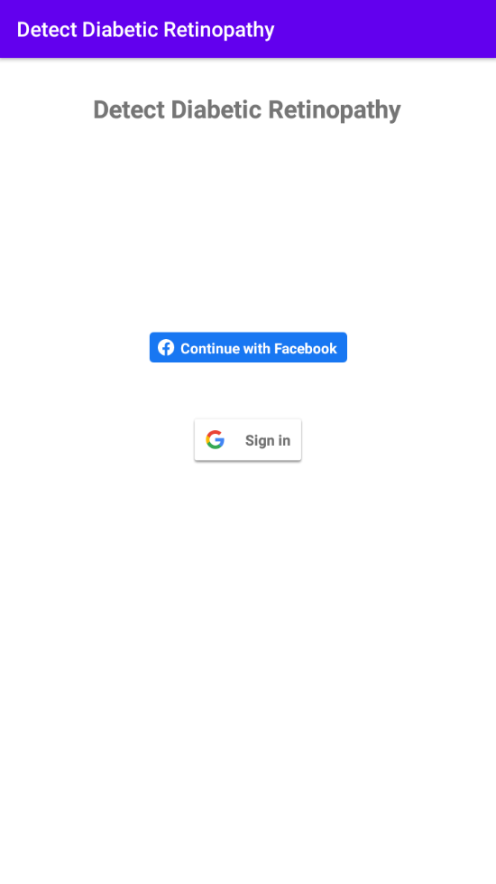
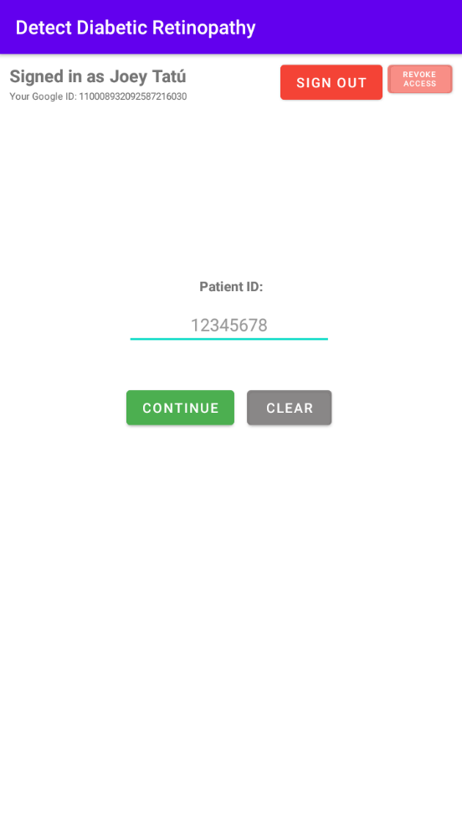
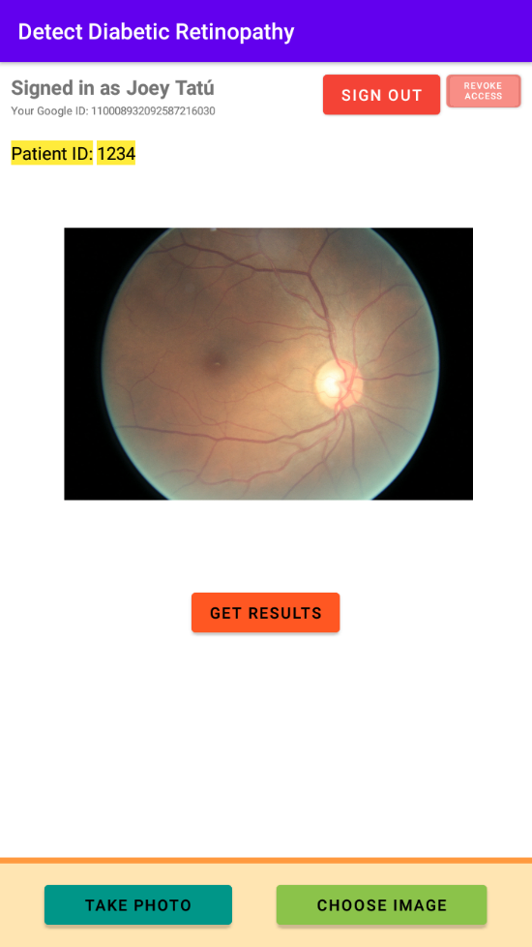
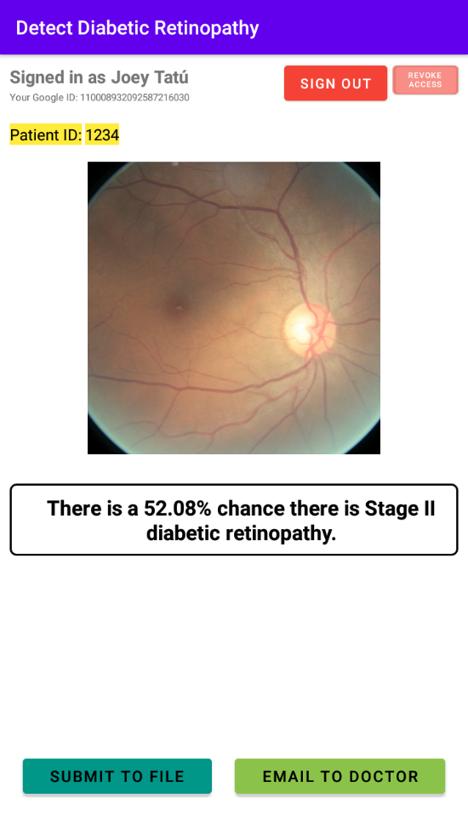
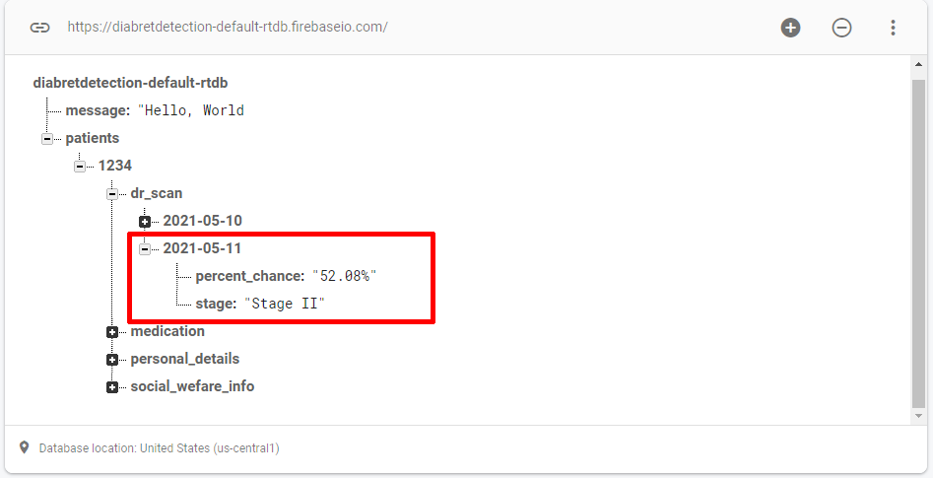
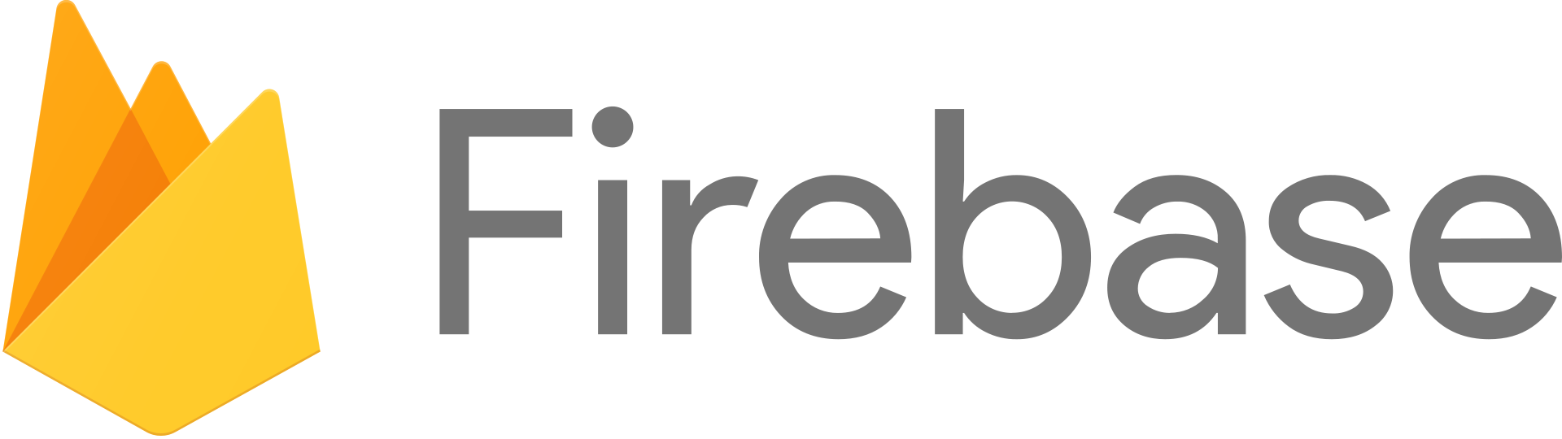
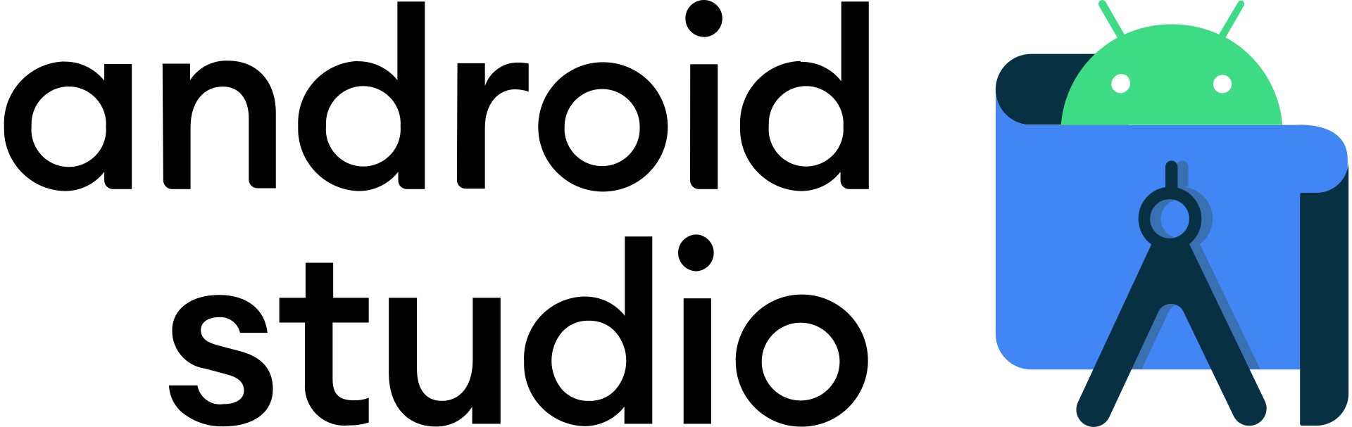
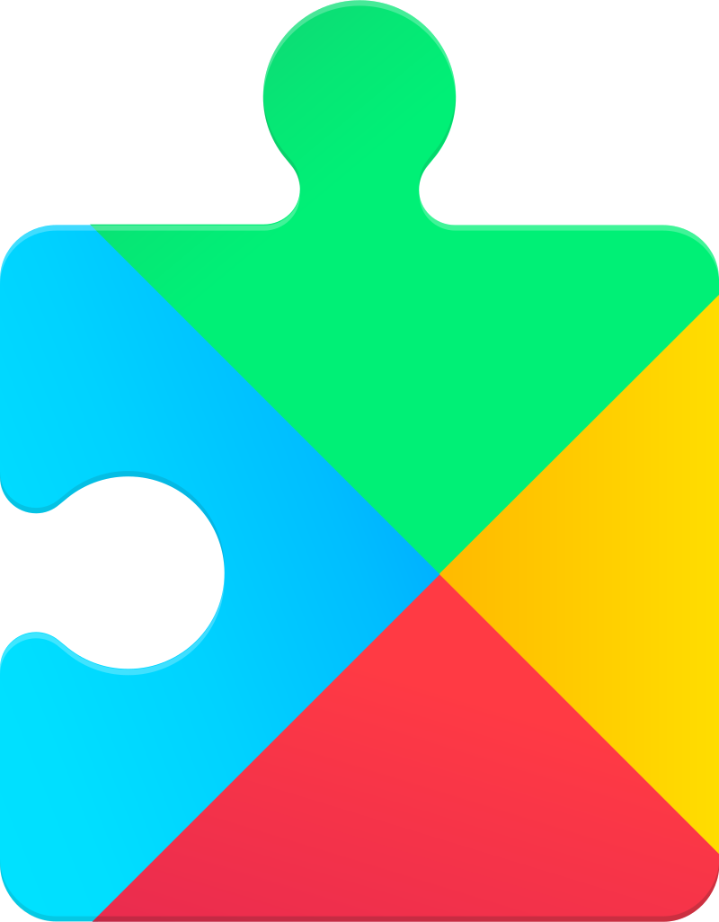





Joey Tatú – BSc (Honours) in Computing – Software Development
Automatic Retinopathy Detection Using
Digital Image Processing via a Smart Device
Abstract:
I have built an Android application that tests for diabetic retinopathy. Diabetic retinopathy is a complication of diabetes that, if left undiagnosed, can lead to blindness. My application will allow untrained medical staff, who are not eye doctors, to screen the retinas of a patient’s eyes for signs of damage
Project Explanation
Screenshots
The Project involves creating an Android application that tests for diabetic retinopathy. The application will allow untrained medical staff, who are not eye doctors, to use the application to screen for diabetic retinopathy in a patient.
Diabetic retinopathy is classed in stages from I to V, where stage 0 is where a patient does not have any issues, stage I is a mild case and stage V is the most
severe case.
During the creation of the application, a model maker called TensorFlow Lite was used to create a model of reference photos of the five stages of diabetic retinopathy. A photo of the patient’s eye is uploaded to the device and is compared to the reference images in the model.
The application highlights where there is an issue and shows the probability of a match as a percentage and what stage of dialethic retinopathy the patient has. These results are also sent to the patient’s file via mobile Internet or local Wi-Fi. All communication between the device and database is encrypted.
If the probability result is over 60%, the patient may have diabetic retinopathy. If this is the case, they are referred to the eye doctor for a more in-depth scan.
The application uses Google and Facebook login features to identify the medical staff using the application and who is performing the screening on a patient.
This application assists in detecting diabetic retinopathy and allows the eye doctor’s time to be dedicated to patients with diabetic retinopathy. This can also severely decrease wait times for appointments.
3. 4.
1. 2.
The user can sign in with Google of Facebook. Their ID and name are stored.
The user enters the patient’s ID, which is also stored. From here, the user can sign out or revoke access to Google or Facebook.
The image is selected from either the camera or Gallery.
The app compares the image to the previously generated TensorFlow Lite model and provides a calculated result.
After selecting “Submit”, the results are sent to the database.
5.
Technologies used
Google Play Services

